Slide 1
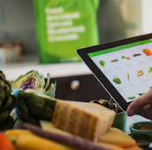
Instacart
Analysis
Parin Patel

Slide 2
Objective
1. Analyze the Instacart Dataset Using Python
2. Identify User and Product Trends
3. Predict the Next Order By the Customer

Slide 3

Data Source
Data is sourced from Kaggle
https://www.kaggle.com/c/instacart-market-basket-analysis/data
Dataset is a relational set of files describing customers' orders over time.
It contains a sample of over 3 million grocery orders from more than 200,000 Instacart users.
Following files are used
aisles.csv
departments.csv
order_products_prior.csv
order_products_train.csv
orders.csv
products.csv

Slide 4
Total Orders - 3,421,083
Unique Users –
206,209
(Across All Orders)
Unique Products - 49,688
Data
Distribution

Slide 5
Product Category Hierarchy
Product
Aisle
Department
Most specific reference. Refers to the Item (Banana, Milk, Etc.)
Specific food category. Different variations of the similar product types
General food category. Different products that are not similar (Produce, Bulk Items)

Slide 6
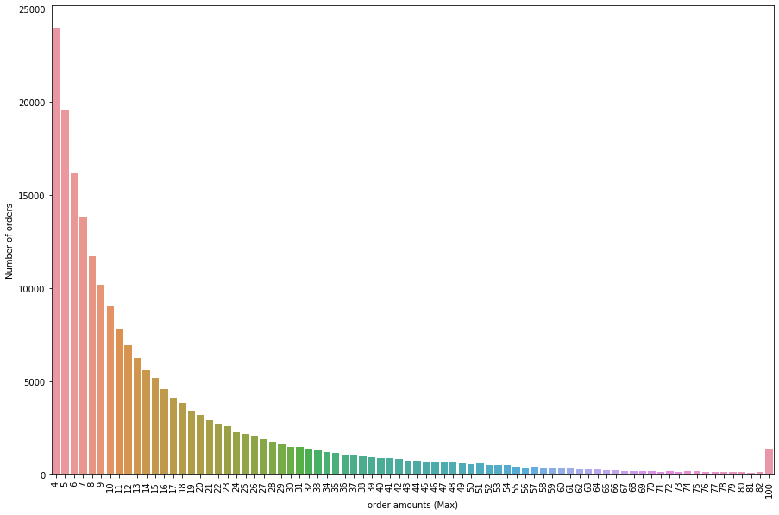
Orders
Per
User
Number of customers decrease as the number of order per customer increases
Avg number of orders per user = 16.59

Slide 7
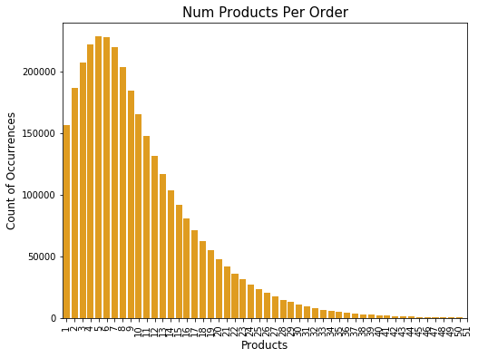
Products Per Order
Number of orders decrease as the number of products per order increases
Average order size = 10.08

Slide 8
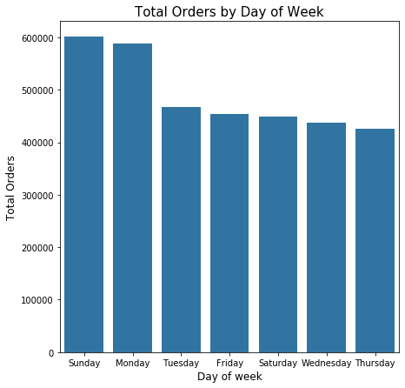
ORDERING
BEHAVIOR
Number of the orders decreases during the week
Highest number of orders are placed on Sunday, followed by Monday.

Slide 9
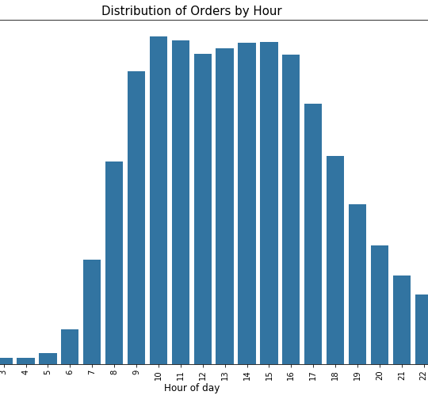
ORDERING BEHAVIOR – BY DAY
Maximum orders are placed around afternoon.
Orders are very less in early morning.
Orders gradually decrease towards night time.

Slide 10
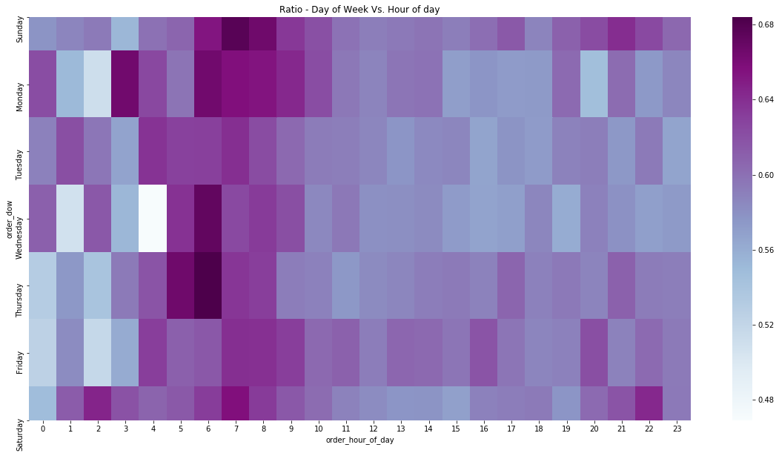
When Do People Order?
Time vs Day ANALYSIS

Slide 11
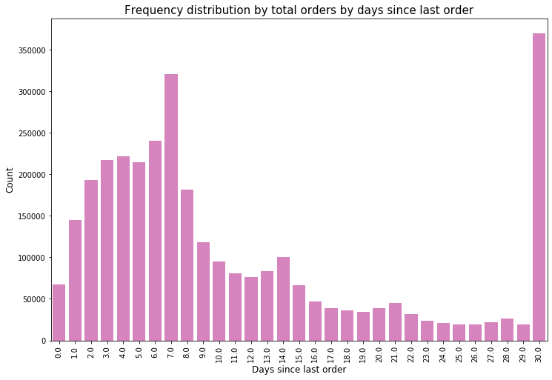
DISTRIBUTION:
RE-ORDERING
Most customers order every week, fortnight and monthly.
50% of customers re-order after about a week of their last order.
Re-order percentage = 59%

Slide 12
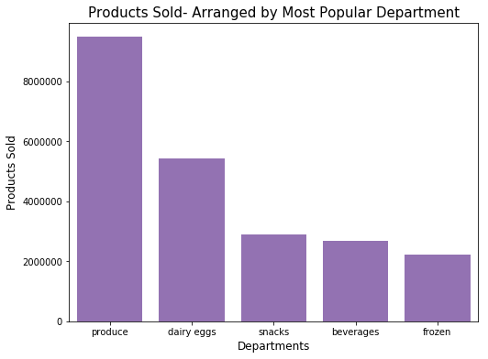
MOST POPULAR DEPARTMENTS
Produce dominate the sales
Dairy snacks beverages and frozen still account for sale of more than 2 Million items

Slide 13
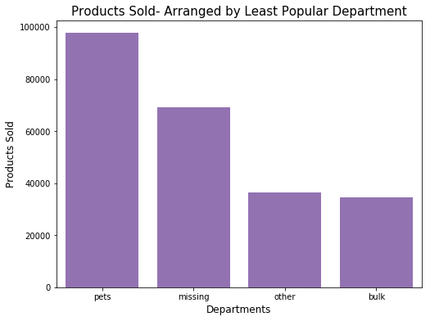
Least Popular
Departments
Pets and bulk products are less frequently ordered.

Slide 14
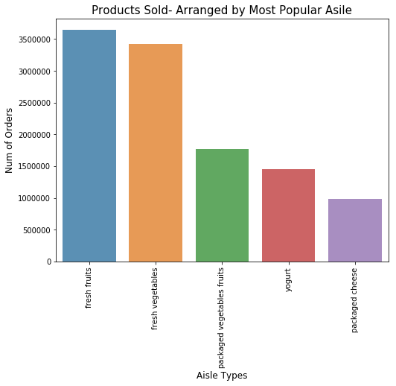
Most Popular Aisles

Slide 15
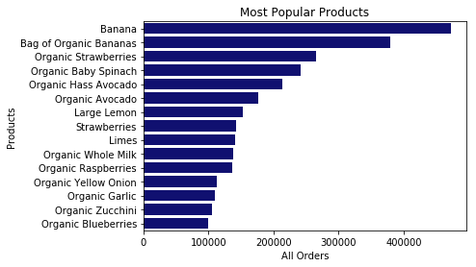
Popular Products
Fruits and vegetables are the most bought by customers

Slide 16

On average, users had about 16 -17 orders, with about 10 products per order
Highest user ordering was found to be on Sunday, followed by Monday.
Ordering behavior - we found that around half of customers re-ordered within about a week of their last order
We predict that orders are 30-40% more likely to occur on Sunday or Monday than another day of the week.
Users re-ordered the same products about 59% of the time
Most ordered Produce (fresh fruits and vegetables) from Instacart.
Users did not prefer to use Instacart to order Pet and bulk items.
The most popular individual items bout by customers was Bananas
Conclusion
Therefore, based on our analysis- we can expect that customers are likely to buy fresh fruits or vegetables 1-7 days after their last order. In this order, we can expect them to either buy organic or nonorganic bananas.

